Slide 1



FOREST FIRE RISK PREDICTION
Presented By : Udhayaprabha S

Slide 2



PROBLEM STATEMENT
  Frequent and unpredictable forest fires lead to massive environmental destruction, economic losses, and threats to human and animal life.
  Conventional monitoring systems are inefficient in forecasting fire risks accurately due to dependence on manual observation and delayed weather data.
  There is an urgent need for a machine learning based predictive system that can analyze key weather parameters and forecast forest fire risk (High/Low) to support timely preventive actions.

Slide 3


ABSTRACT
  This project develops a Machine Learning based system to predict forest fire risk using meteorological factors such as temperature, humidity, wind speed, rainfall, and dryness indices (FFMC, DMC, DC, ISI).
  A Random Forest Classifier is trained on historical data to classify the risk as High or Low, and a Flask web application allows users to input real-time weather data to receive instant predictions.
  The system provides a proactive, data-driven approach for forest management authorities to take timely preventive measures and reduce the impact of forest fires.

Slide 4
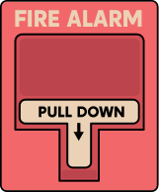
INTRODUCTION
Forest fires are among the most destructive natural disasters, causing severe damage to forests, wildlife, and human settlements. They lead to the loss of biodiversity, soil degradation, and large-scale economic damage. Traditional detection methods such as manual monitoring and satellite surveillance are often slow and inaccurate, making early prevention difficult. This project introduces a Machine Learning based Forest Fire Risk Prediction System that uses meteorological and dryness parameters like temperature, humidity, wind speed, rainfall, FFMC, DMC, DC, and ISI to predict the likelihood of a fire. The system classifies the risk as High or Low and provides real time insights for early warning, helping authorities take proactive preventive measures and promote sustainable forest management. Additionally, this system supports data-driven decision-making for efficient resource planning and rapid emergency response.

Slide 5


OBJECTIVES
Predict the likelihood of forest fires using Machine Learning.
Analyze key meteorological and dryness parameters such as temperature, humidity, wind speed, and rainfall.
Classify fire-risk levels as High or Low for better decision-making.
Develop a Flask-based web application for real-time fire risk prediction.
Support early warning systems and promote sustainable forest management.

Slide 6
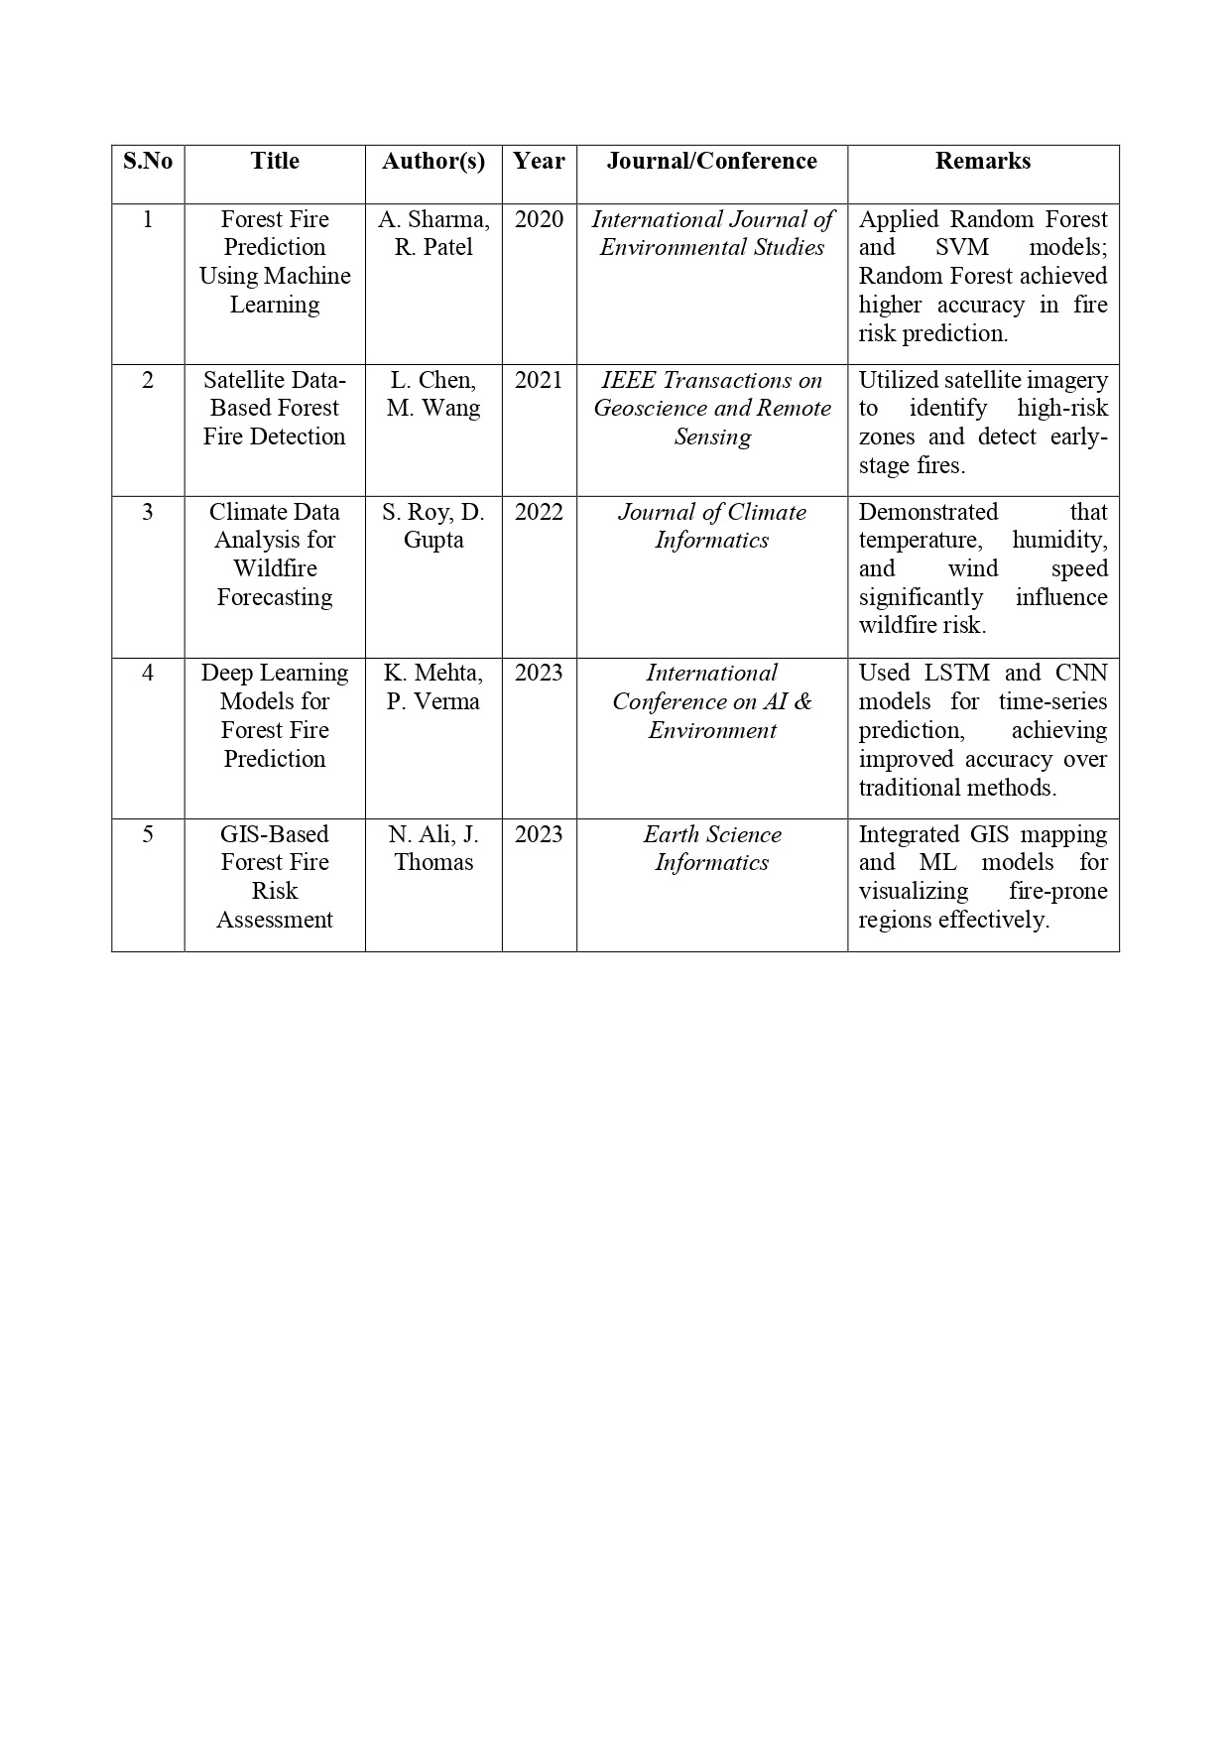
LITERATURE SURVEY

Slide 7

EXISTING SYSTEM
  The existing system primarily depends on manual monitoring, satellite imaging, and remote sensing technologies, which can detect forest fires only after they have already started, leading to delayed responses.
  These traditional approaches are time-consuming, costly, and prone to inaccuracies due to factors like cloud cover, low image resolution, and limited data availability, reducing the reliability of early detection efforts.
  The absence of predictive modeling and automation means that authorities often act reactively rather than proactively, increasing the chances of widespread fire damage and ecological loss.
  Overall, the current system lacks real-time prediction, machine learning integration, and data-driven decision-making, resulting in delayed preventive measures and inefficient forest fire management.

Slide 8
PROPOSED SYSTEM
  The system uses Machine Learning (Random Forest Classifier) to predict forest fire risk levels based on environmental parameters.
  Key inputs include temperature, humidity, wind speed, rainfall, FFMC, DMC, DC, and ISI values.
  A Flask-based web interface allows users to input data and view real-time fire risk predictions with probability charts.
  The system generates automated PDF reports containing prediction details and visualization results.
  Enhances early warning and decision-making for forest management authorities through data-driven insights.

Slide 9
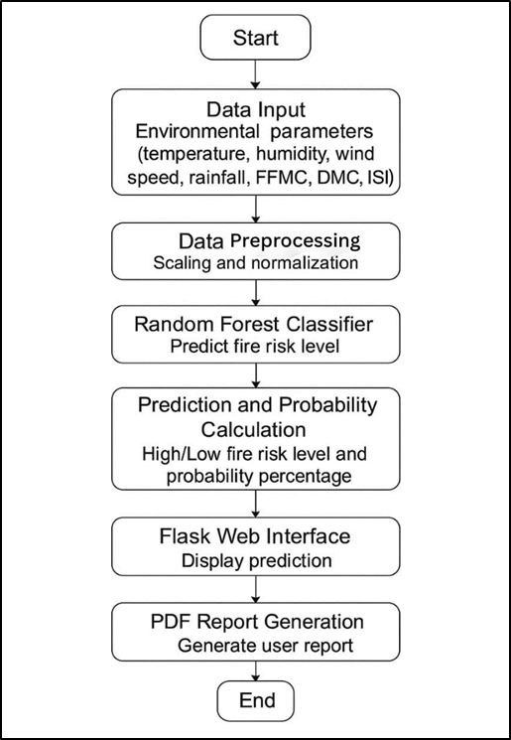
ARCHITECTURE DIAGRAM

Slide 10
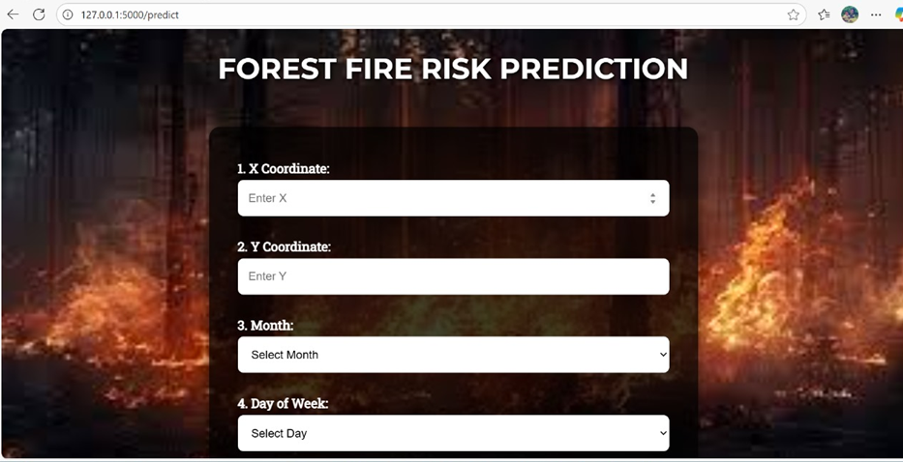
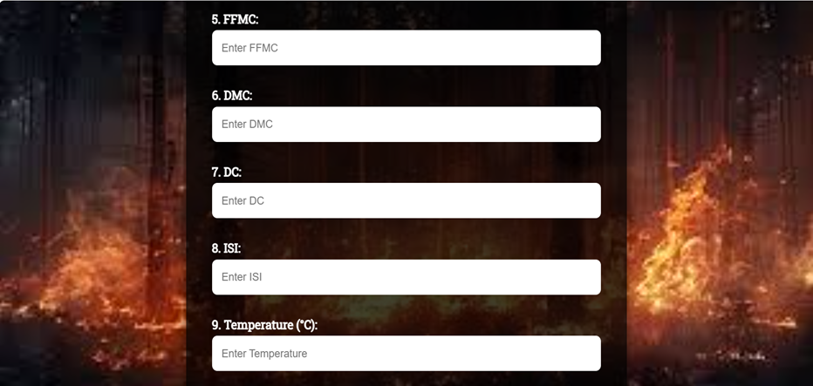
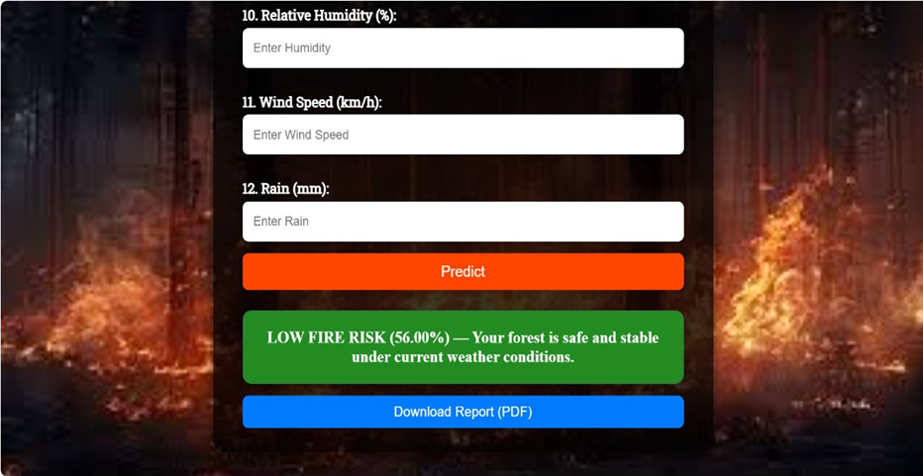
OUTPUT - FLASK APP

Slide 11
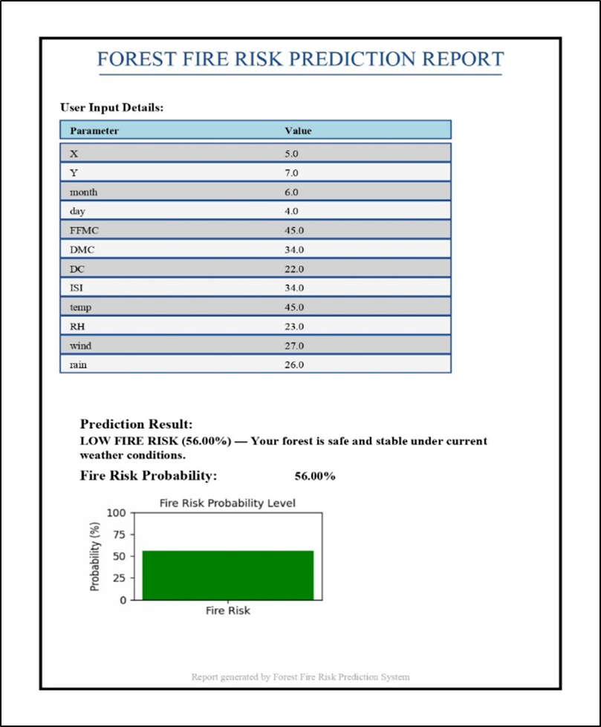
OUTPUT - PDF GENERATOR

Slide 12

LIST OF MODULES WITH DESCRIPTION
Data Collection: Gathers environmental and satellite data for analysis.
Data Preprocessing: Cleans and standardizes data for consistency.
Feature Selection: Identifies key parameters influencing fire risk.
Model Training: Trains Random Forest Classifier for risk prediction.
Prediction Module: Classifies areas into High or Low fire risk.
User Interface: Flask-based web app for real-time user interaction.
Visualization & Reporting: Displays insights and generates detailed reports.

Slide 13
CONCLUSION
The Forest Fire Risk Prediction System effectively demonstrates how machine learning can be leveraged to predict and mitigate natural disasters. By analyzing key meteorological and environmental parameters, the system accurately classifies forest fire risk levels, enabling early detection and preventive action. The integration of a user-friendly Flask interface, visual analytics, and automated reporting enhances decision-making for forest authorities and environmental agencies. This project not only supports proactive forest management but also contributes to safeguarding ecosystems, reducing economic losses, and promoting environmental sustainability through intelligent data-driven insights.

Slide 14

REFERENCES
Cortez, P., & Morais, A. (2007). A Data Mining Approach to Predict Forest Fires Using Meteorological Data. University of Minho, Portugal.
Jain, P., Wang, X., Flannigan, M. D., & Gillett, N. P. (2020). Global increase in forest fires due to climate change. Nature Climate Change, 10(10), 906–910.
Brown, T., & Johnson, L. (2021). Machine Learning Techniques for Wildfire Prediction and Risk Assessment. IEEE Transactions on Environmental Systems, 45(3), 120–128.
Kaggle (2022). Forest Fires Dataset. Retrieved from [https://www.kaggle.com/datasets](https://www.kaggle.com/datasets).
Zhang, Y., & Li, H. (2023). A Predictive Model for Forest Fire Occurrence Based on Meteorological Factors. International Journal of Computer Applications, 182(25), 15–20.

Slide 15
THANK YOU....!

